Slide 1
AI-Powered Student Grading & Teacher Guidance Automation System
25-26J-162

Slide 2

Introduction
Information and Communication Technology (ICT) is an important subject in the Sri Lankan G.C.E. O/L syllabus. Many students find it difficult to understand programming logic, databases, networking, and theory-based ICT topics. Teachers also face problems with manual marking, finding student weaknesses, and preparing balanced question papers. To solve these problems, this research introduces an AI-based Learning Management System that helps teachers and students through automated marking, smart analysis, and personalized learning support.

Slide 3






Our Team
Supervisor
Prof. Samantha Rajapaksha
Head | Department of Information Technology
Co-Supervisor
Ms. Bhagyani Chathurika
Academic Coordinator (Matara) | Senior Lecture
Ushan
Malshan
Ridmi
Lashini

Slide 4
Research Problem
Manual Evaluation Issues
  Marking ICT answer sheets is time-consuming and prone to human error.
  Providing individual feedback to each student is difficult.
Lack of Personalized Learning
  Students have different knowledge levels, but all receive the same teaching method.
  Weak areas (e.g., algorithms, databases, networking) are not identified early.
Question Paper Preparation Challenges
  Teachers struggle to prepare balanced papers aligned with the O/L ICT syllabus and cognitive levels.
Limited Performance Analysis
  No intelligent system to analyze student performance trends and learning gaps.

Slide 5
Research Objective
Main Objective
Sub Objective
To automatically evaluate O/L ICT answer sheets and assign marks accurately.
To provide constructive feedback based on student answers.
To analyze student performance and identify weak ICT topics.
To generate personalized learning recommendations aligned with the O/L ICT syllabus.
To assist teachers in automated question paper generation based on syllabus topics and difficulty levels.
To develop an AI-powered Learning Management System that improves teaching, assessment, and learning outcomes for O/L ICT students.

Slide 6
Design Excellence of the Overall Solution
Design Principle | Implementation | Impact
Modular Architecture | 4 independent components with REST APIs | Easy maintenance, parallel development, scalability
Complete Automation Loop | Question Generation → Grading → Analysis → Personalized Learning | End-to-end teacher-student feedback automation
AI-Powered Intelligence | Advanced ML models (Qwen2-VL, BERT, GNN/BKT) | Accurate automation, reduced workload, smart insights
Multi-Platform Design | Web for teachers, Mobile for students | Role-based access, flexible usage
Unified Data System | Centralized Firebase database, shared APIs | Seamless integration, real-time data consistency

Slide 7
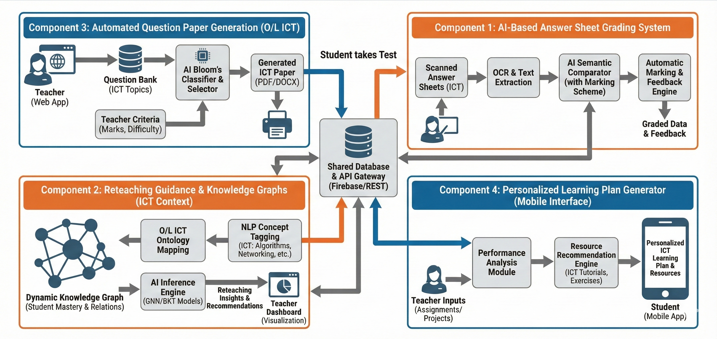
Overall System Architecture Diagram

Slide 8

IT22243362
PATHIRAJA P.U.M
OCR Module and AI Grading
BSc. (Hons) in Information Technology Specialization in Information Technology
IT22243363 | Pathiraja P.U.M | 25-26J-162

Slide 9
How The Solution Will Address the Sub-Problem
Sub-Problem | Solutions
Manual marking | AI automatically marks O/L ICT answer sheets using OCR.
Marking errors | AI ensures accurate and consistent evaluation.
No feedback | System generates automatic feedback for answers.
Time consumption | Marking time is greatly reduced for teachers.
Record handling | Results are stored digitally in the LMS.
IT22243363 | Pathiraja P.U.M | 25-26J-162

Slide 10
Design Excellence & Contribution
The component follows a clear and modular design, making the system easy to understand and maintain.
OCR and AI models are integrated smoothly to ensure accurate and efficient answer evaluation.
Automatic feedback generation adds value by helping students understand their mistakes.
This component significantly contributes to improving assessment quality in O/L ICT education.
IT22243362 | Pathiraja P.U.M | 25-26J-162

Slide 11
Current Implementation Status
Current Status | Pending Tasks
1. Model Fine-Tuning: Qwen2-VL-7B-Instruct + all-MiniLM-L6-v2 | 1. Backend API: Flask/FastAPI endpoints development
2. UI/UX Design: Figma design file completed | 2. Database Setup: Firebase schema and integration
3. OCR Pipeline: Text extraction & batch processing | 3. Frontend Development: Convert Figma to web interface
4. Evaluation Engine: Semantic comparison, marking, feedback | 4. Deployment: Service deployment and documentation
 | 5. Integration APIs: Connect with Component 2,3, and 4
IT22243362 | Pathiraja P.U.M | 25-26J-162

Slide 12
Functional & Non-Functional Requirements
Functional Requirements | Non-Functional Requirements
Upload and process handwritten answer sheets | OCR accuracy ≥ 85%, Grading accuracy ≥ 90%
Automatically assign marks based on marking scheme | Process each answer sheet within 10-15 seconds
Generate feedback for student answers | System uptime ≥ 99% with error handling
Allow teachers to review and adjust grades | Secure data storage and user authentication
Store and share results with other components | Support common image formats (JPG, PNG, PDF)
IT22243362 | Pathiraja P.U,M | 25-26J-162

Slide 13
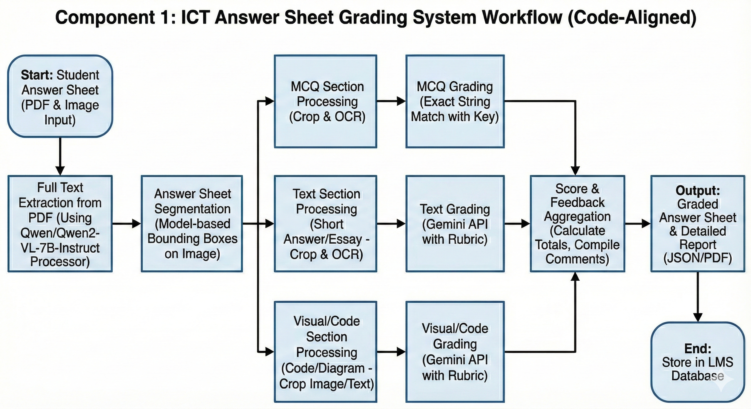
System Diagram
IT22243362 | Pathiraja P.U,M | 25-26J-162

Slide 14
IT22103154
M Wanniarachchi W.A.P
AI-POWERED TEACHER RETEACHING GUIDANCE AUTOMATION SYSTEM
BSc. (Hons) in Information Technology Specialization in Information Technology
IT22103154 | M Wanniarachchi W.A.P | 25-26J-162

Slide 15
How The Solution Will Address the Sub-Problem
Sub Problem
Solution Approach
Teachers currently rely on total marks to plan revision.
Total marks do not show concept-level weaknesses.
Manual analysis of answers is time-consuming.
Teachers need clear guidance on what exactly to reteach.
Uses exam marks and answers from Component 1.
Maps student answers to ICT topics using a topic ontology.
Analyzes performance topic-wise, not score-wise.
Generates a clear re-teach topic list for teachers.
Generates Mini Lessons according to weak areas.
IT22103154 | M Wanniarachchi W.A.P | 25-26J-162

Slide 16

Design Excellence & Contribution
Uses ICT Topic Ontology to model subject structure.
Applies Sentence Transformers to understand answer meaning.
Uses Bayesian Knowledge Tracing (BKT) to track learning state.
Uses Graph Neural Networks (GNN) to capture topic relationships.
More accurate than traditional mark-based analysis.
IT22103154 | M Wanniarachchi W.A.P | 25-26J-162

Slide 17
Current Implementation Status
Current Progress
Tasks to be Done
ICT topic ontology defined.
Sentence Transformer integrated.
BKT and GNN models implemented.
Class-level weak topic detection completed.
Currently completed: Model-level implementation only.
Extend ontology to cover full ICT syllabus.
Improve accuracy using additional similarity measures.
Integrate teacher dashboard UI.
Add individual student-level recommendations.
Complete full system integration and testing.
IT22103154 | M Wanniarachchi W.A.P | 25-26J-162

Slide 18
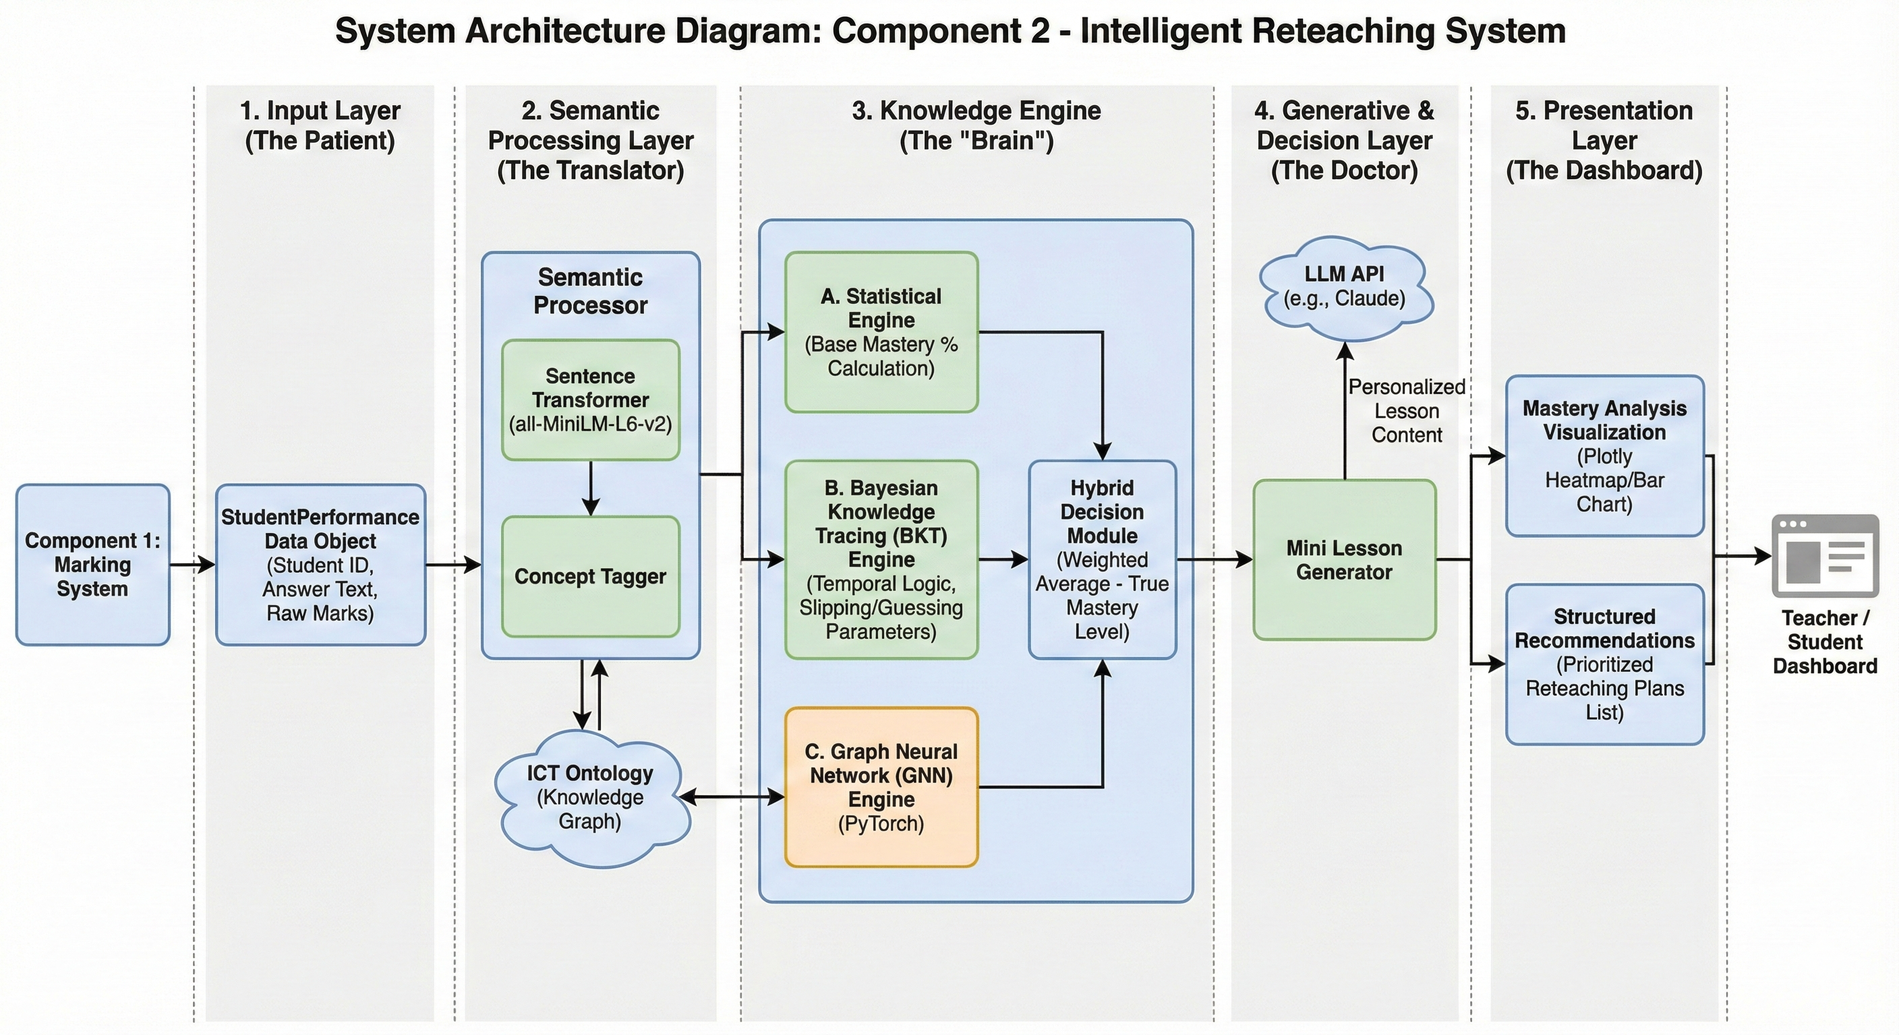
System Architecture Diagram

Slide 19
Functional & Non-Functional Requirements
Functional | Non-Functional
Analyze student marks and written answers. | High accuracy in topic identification.
Identify ICT topics related to each answer. | Fast processing for classroom use.
Calculate topic-wise performance percentages. | Reliable results across different exams.
Generate a list of weak topics for reteaching. | Secure handling of student assessment data.
Visualize results using charts.
IT22103154 | M Wanniarachchi W.A.P | 25-26J-162

Slide 20

IT22120052
Hettiarachchi R.H
Adaptive Question Paper Generation Engine.
BSc. (Hons) in Information Technology Specialization in Information Technology
IT22120052 | Hettiarachchi R.H | 25-26J-162

Slide 21
How The Solution Will Address the Sub-Problem
Sub Problem
Solution Approach
Teachers manually create exam papers.
Difficult to ensure balanced difficulty levels.
Papers may not fully cover the required syllabus (Grade & Term).
Manual question selection is time-consuming and subjective.
Lack of consistency across different exam papers.
Uses a centralized question bank uploaded by teachers.
Classifies questions using Bloom’s Taxonomy with AI.
Filters questions using Grade-wise and Term-wise syllabus structure.
Automatically balances easy, medium, and hard questions.
Generates a standardized exam paper with answer key.
IT22120052 | Hettiarachchi R.H | 25-26J-162

Slide 22
Design Excellence & Contribution
Uses ICT syllabus-based ontology to model Grade 10 & 11 subject structure.
Applies Sentence Transformer (NLP) to understand question meaning.
Automatically classifies questions using Bloom’s Taxonomy
Ensures balanced syllabus and cognitive level coverage
More effective and fair than random or manual question selection.
IT22120052 | Hettiarachchi R.H | 25-26J-162

Slide 23
Current Implementation Status
Current Progress.
Tasks to be Done
MCQ question paper generation completed
Question bank creation and management completed.
ML model classifies questions using Bloom’s Taxonomy.
Syllabus-based filtering implemented
(Grade 10 & 11 – Term 1, 2, 3)
Automatic Word document generation with answer key
Implement Essay question paper generation
Extend Bloom’s level handling for higher-order questions
Improve model accuracy with more training data
Integrate with online grading system
Add teacher-level customization for paper difficulty
IT22120052 | Hettiarachchi R.H | 25-26J-162

Slide 24
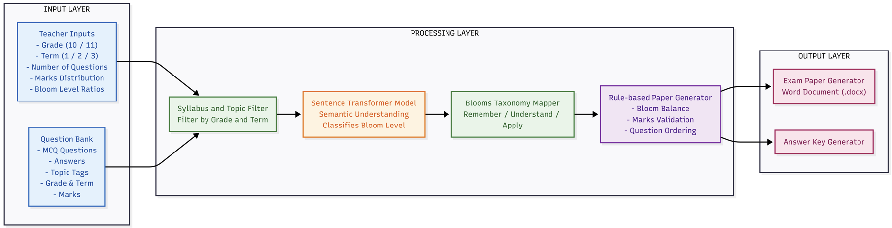
System Architecture Diagram

Slide 25
Functional & Non-Functional Requirements
Functional | Non-Functional
Allow teachers to upload and manage MCQ questions | System should generate a question paper within a few seconds
Support Grade 10 & 11 ICT syllabus & Allow selection of Term (1 / 2 / 3) | Model should provide consistent and reliable Bloom classification
Automatically classify questions using Bloom’s Taxonomy | System should be easy to use for teachers with minimal technical knowledge
Export question paper as a Word (.docx) document | System should be scalable to support essay questions in future
Generate answer key automatically | Data should be secure and accessible only to authorized users
IT22120052 | Hettiarachchi R.H | 25-26J-162

Slide 26
IT22095480
Jayasooriya L.T
AI Powered Personalized Learning Plan Generator
BSc. (Hons) in Information Technology Specialization in Information Technology
IT22095480 | Jayasooriya L.T | 25-26J-162

Slide 27
How The Solution Will Address the Sub-Problem
Sub Problem
Solution Approach
Students only see total marks without understanding strengths and weaknesses
No personalized guidance on what to study next
Students lack direction on where to find relevant resources
Generic study plans don't address individual learning gaps
No accessible way for students to track progress over time
Uses exam results from Components 1 and 2, plus assignment data
Analyzes performance to identify strong and weak areas
Generates personalized learning plans for each student
Recommends relevant study materials (articles, videos, exercises)
Delivers insights through a mobile app accessible anytime
Provides term-wise progress tracking and adaptive recommendations
IT22095480 | Jayasooriya L.T | 25-26J-162

Slide 28
Design Excellence & Contribution
Multi-Source Data Integration with weighted aggregation (40% tests, 25% assignments, 20% projects, 10% activities, 5% participation) for comprehensive performance analysis
Sentence Transformer Embeddings (all-MiniLM-L6-v2) converting textual content into 384-dimensional vector representations for semantic understanding
Similarity Algorithm computing angular distance between student need vectors and resource embedding vectors to identify optimal learning materials
Content-Based Recommendation Engine using semantic similarity thresholds and difficulty-level matching for personalized resource selection
Interactive Visualization Dashboard providing multi-dimensional performance analytics through gauge charts, bar charts, and pie charts
IT22095480 | Jayasooriya L.T | 25-26J-162

Slide 29
Current Implementation Status
Current Progress
Tasks to be Done
Expand learning resources database with more diverse videos, articles, and interactive quizzes
Build mobile app frontend (React Native or Flutter) for student interface
Integrate persistent database (Firebase/PostgreSQL) for storing student data and learning plans
Connect with Components 1, 2, and 3 via REST APIs or shared data pipeline
Implement user authentication, role-based access, and push notifications
Conduct full system testing with real student data and deploy mobile application
Add real-time progress tracking and plan regeneration features
Student Performance Analyzer implemented with multi-source data integration and weighted performance calculation
Resource Recommendation Engine using Sentence Transformers (MiniLM-L6-v2) for semantic matching completed
Personalized Learning Plan Generator functional with goal setting, study plans, and improvement tracking
Visualization module (charts, bar charts, pie charts) using Plotly completed
Core AI analysis modules including pattern recognition, trend analysis, and confidence scoring implemented
IT22095480 | Jayasooriya L.T | 25-26J-162

Slide 30
Functional & Non-Functional Requirements
Functional Requirements | Non-Functional Requirements
Retrieve and aggregate data from Components 1, 2, and teacher inputs | High accuracy in weakness identification and resource matching
Analyze student performance across multiple assessment types | Fast mobile app performance
Identify weak and strong topics using AI-driven analysis | Scalable to handle multiple students simultaneously
Generate individualized learning plans per student | Secure data storage and user authentication
Display term-wise performance reports and visualizations | Usability for target audience
Recommend relevant online resources (videos, articles, exercises) | Reliability of data synchronization
IT22095480| Jayasooriya L.T| 25-26J-162

Slide 31
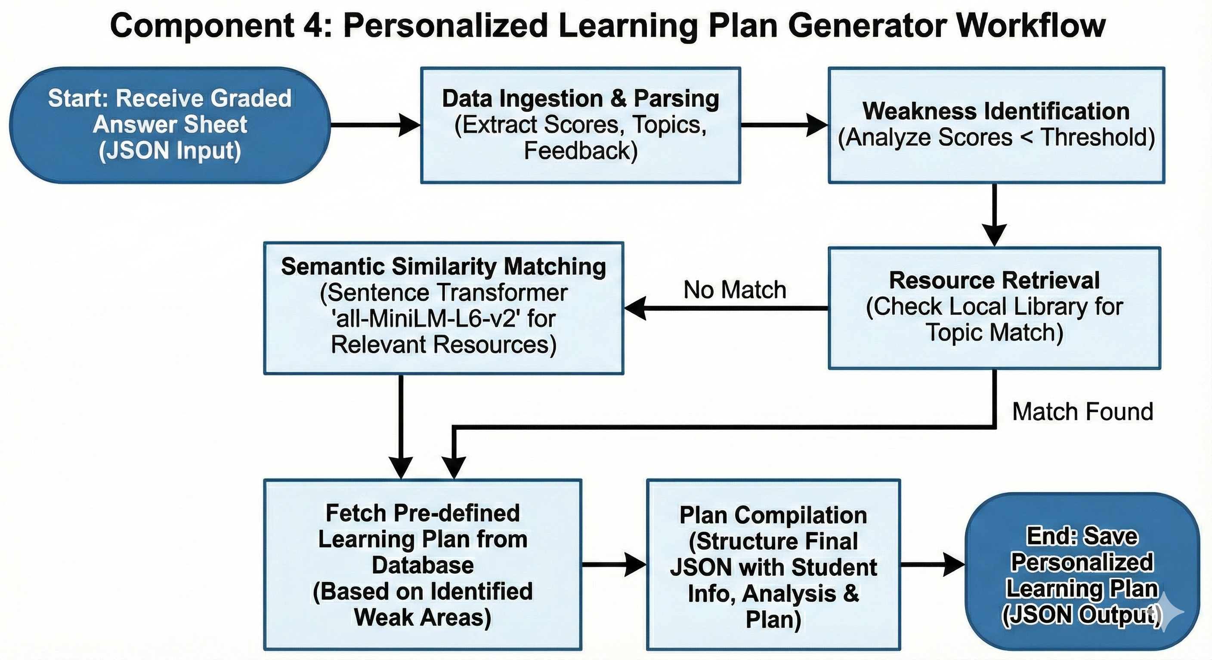
System Diagram
IT22095480| Jayasooriya L.T | 25-26J-162

Slide 32
Customer Persona
Primary Users:
O/L ICT Teachers in Sri Lanka
O/L ICT Students
School ICT Departments
User Needs:
  Faster and accurate paper marking
  Easy identification of student weaknesses
  Personalized learning support for students
25-26J-162

Slide 33
Market Size
Over thousands of secondary schools in Sri Lanka offer O/L ICT.
Each school has hundreds of O/L ICT students annually.
High demand for digital and AI-based education tools.
Potential users include:
          Government schools
          Private schools
          Tuition institutes
25-26J-162

Slide 34
What Is Unique in Our Solution
AI-based automated answer sheet evaluation for O/L ICT.
Personalized feedback and learning support.
Syllabus-aligned question paper generation.
Designed specifically for the Sri Lankan O/L ICT syllabus.
Reduces teacher workload while improving learning quality.
25-26J-162

Slide 35
How Will the Cost Be Recovered
Subscription plans for schools and tuition institutes.
Monthly or yearly licensing for teachers.
Premium features such as:
            → Advanced reports
            → AI feedback customization
Free basic version with paid upgrades.
25-26J-162

Slide 36
Thanks!
Do you have any questions?

